Slide 1
Number Plate Detection and Integration with MySQL and IoT
As an Engineer and a Indian citizen, Parking is major problem in our country as well in our surroundings such as Apartments, Educational Institutions etc.
This problem can be autonomously monitored.
Senthil Pitchappan V
3rd Year ECE (17ECE51)
913117106072

Slide 2
Abstract
Vehicle parking is an important component within any transportation system, whereby vehicles are often parked at destinations. With an increased number of motor vehicles on roads especially in developing countries, there is need for a vehicle identification mechanism that is effective, affordable and efficient.
In most academic institutions, apartments and car parks, the ongoing car park entry registration process for visitors, staff or students entering the institution involves a security guard having to confirm membership details by checking for membership sticker on the windscreen of the vehicle or by checking the driver's identification card.
This process of writing is tedious and time consuming and is prone to inaccurate recordings, furthermore the backup and sharing of this vehicle information is difficult because the data is hard copy.

Slide 3
INNOVATION IDEA
Each and every number plate is processed using image processing in Spyder (Python) or MATLAB.
Every car has its own parking lot in an area. Our project helps the drivers as well as the security correctly park the in the respective place.
While the car enters the parking lot, the car number is obtained. This car number is correlated and compared in the database and finds the correct parking lot number.
Parking lot number is delivered to the driver and he can park in the specific lot.
Even though, if the driver parks in the wrong lot, it intimates the driver as well the security by a notification.
Car in time and out time, Car number is uploaded to the database and is also intimated i.e. notified to the owner through a web app and android application.

Slide 4
Automatic Bill is generated using in time and out time of the car.
Parking lots in a specific venue can be pre booked using the
Web Application.
If there is any malpractice done by the driver, police accounts is also integrated with the web app, so that theft and other cases can be filled and FIR (if the case is serious) can also be obtained as a PDF in the Web Application it-self.
This Web Application is not only used for Parking Assist, It can also be used in the case Road Accident, Traffic violations etc.
The user can enter the Car Number with the GPS location and the fault they did including the locality.
Then the police officials can do the necessary.

Slide 5
Components
Python Programming
Sypder Software for Image Processing
My SQL Database
Firebase
MIT App Inventor
XAMPP (Local Server)
PHP for Backend
HTML, CSS, JavaScript for Frontend
Open CV and Pytesseract

Slide 6




Process
Image Processing:
1. Grey Scale
2. Filtering of Image
3. Canny Edge Detection
4. Contouring
5. Number Plate Cropping
6. Character Segmentation
Output in Web/Android Application
Statistical Analysis
Tableau
Image Processing and uploading to the server
Image acquisition and Android Inputs

Slide 7
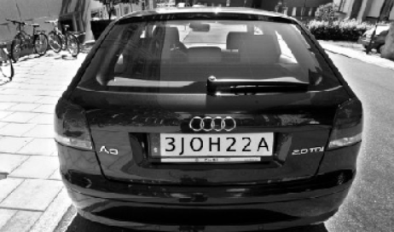
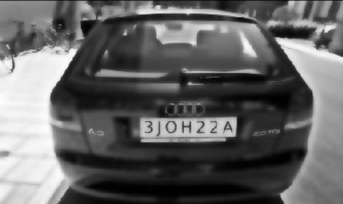
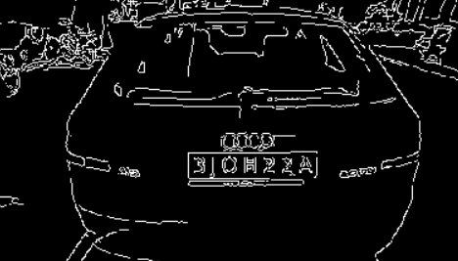
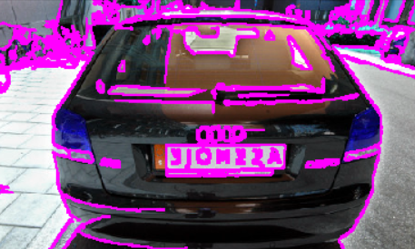
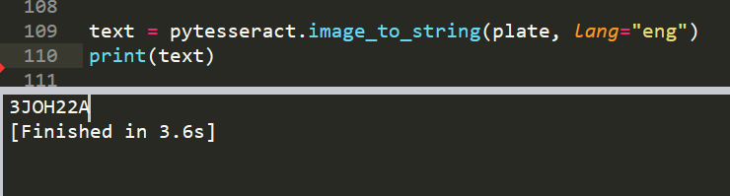
Result
Grey scaled image
Blurred image
Edged image
Cropped image
Contour image
Final Output

Slide 8
My SQL and Web Application
The output from Python is updated to My SQL database using Python.
PHP is used to retrieve data from SQL Database and view it in a Web Application.
This Web Application will be able to send E-Mail, Message, Notification to owner as well as near by police station in a case of emergency.
The owner can him/her self update the GPS location, lot number and in time & out time in her App, pre book parking lots as at times people wont be using Drivers.
A web application will be provided to the drivers, to update the parking lot number, in & out time, GPS location and other information’s
to the owner.

Slide 9
Features
User friendly Web Application for both user and Driver
GPS location
Database Management
Notification in the case of emergency
Bill generation
Police Integration
Pre Booking of Parking lot

Slide 10
Future Scope
Automatic parking System (driver-less)
Live GPS locator
Auto theft alarm

